Slide 1
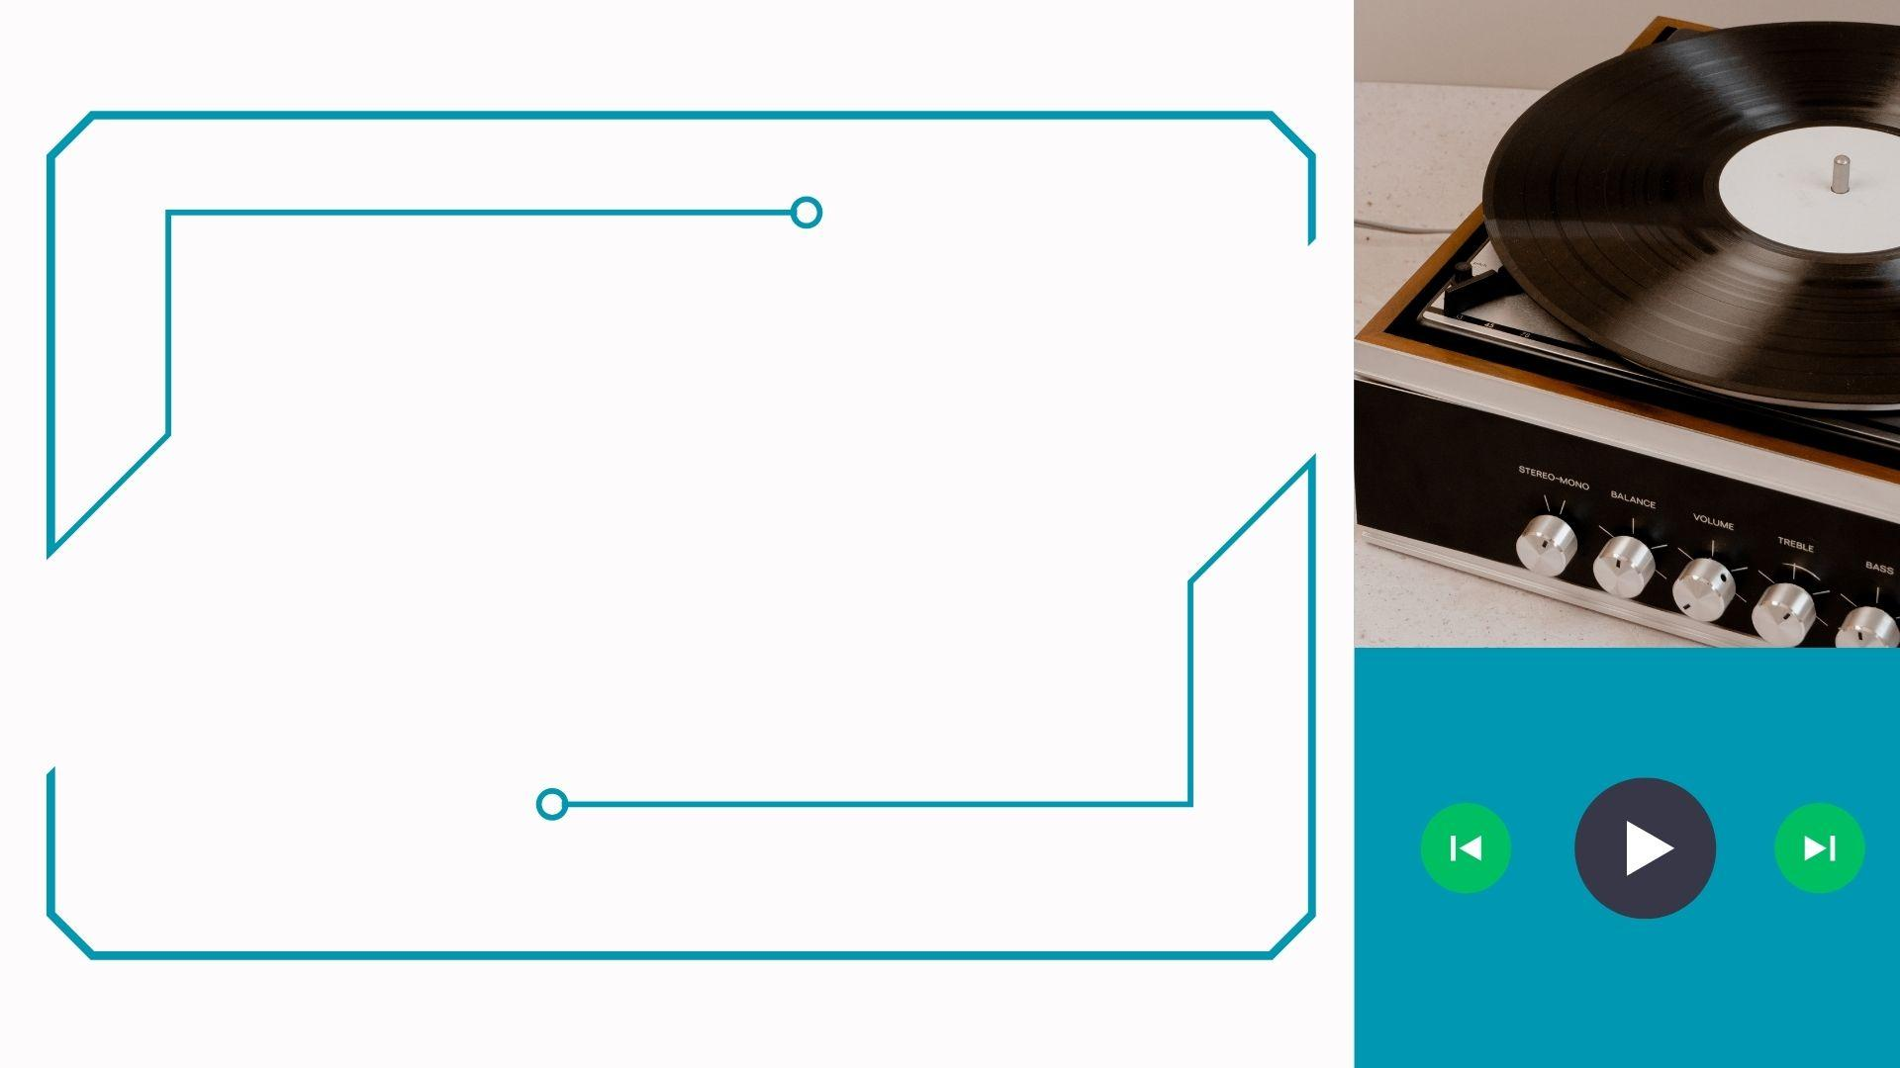
Music Playlist Project with Doubly Linked Lists

Slide 2

CONTENT :
Introduction
Algorithm Advantages Node structure Inserting & Deleting Tracks Traversing & Sorting Conclusion

Slide 3

Introduction
This project aims to develop a robust music playlist management system leveraging the power of doubly linked lists.
Efficient organization of music tracks significantly enhances the user experience by simplifying the process of finding and enjoying favorite music selections.
Doubly linked lists provide several advantages, including seamless navigation through tracks, effortless modifications such as adding or removing songs, and ensuring well-organized playlists for users.

Slide 4

Algorithm : Doubly Linked Lists
“Doubly linked lists consist of nodes, each containing data and two pointers, one pointing to the previous node and one to the next node. This structure facilitates bidirectional traversal, allowing movement both forwards and backwards within the list.”
Features:
Bidirectional Traversal: Doubly linked lists allow traversal in both forward and backward directions, providing flexibility in navigating through the playlist.
Efficient Memory Utilization: While offering bidirectional traversal, doubly linked lists efficiently utilize memory by only storing pointers to the previous and next nodes, reducing memory overhead compared to other data structures.
Dynamic Size: Doubly linked lists can dynamically adjust their size, accommodating the addition or removal of nodes without the need for contiguous memory allocation.
Constant Time Insertion and Deletion at Any Position: Insertion and deletion operations in doubly linked lists can be performed in constant time complexity at any position within the list, making them suitable for dynamic playlist management.
Support for Reversal: Doubly linked lists inherently support reversal operations, allowing for easy implementation of features such as shuffling or reversing the playlist order.

Slide 5
Advantages :
Easy Bidirectional Traversal: Doubly linked lists facilitate navigation in both forward and backward directions, providing users with seamless access to playlist content.
Efficient Insertion and Deletion: Insertion and deletion operations can be performed at any position within the list with constant time complexity, offering flexibility and efficiency in managing the playlist.
Memory Efficiency: Doubly linked lists optimize memory usage by storing only two pointers per node, minimizing overhead compared to other data structures.
Dynamic Size Adjustment: The dynamic nature of doubly linked lists allows for easy resizing as tracks are added or removed, ensuring optimal memory utilization and performance.
Support for Reversal Operations: Reversing the playlist order or implementing features like shuffling becomes straightforward with the inherent support for bidirectional traversal, enhancing user interaction and playlist customization.

Slide 6
Node Structure :
Breakdown:
Each node within the playlist corresponds to a specific music track, serving as a fundamental unit for organizing the playlist content.
Data Part:
The data segment of each node encompasses essential information pertinent to the track, including its title, artist, album, duration, genre, and any additional metadata relevant to the music track.
Pointers:
Within the node structure, pointers are utilized to establish connections with both the preceding and succeeding nodes. This linkage enables seamless navigation throughout the playlist in both forward and backward directions, contributing to an intuitive and user-friendly browsing experience.

Slide 7
Inserting & Deleting Tracks
Insertion:
New tracks are seamlessly integrated into the playlist structure while maintaining the integrity of the list.
Pointers are appropriately updated to establish connections between the new track node and its neighboring nodes, ensuring continuous traversal flow.
Deletion:
Tracks are efficiently removed from the playlist without causing disruption to the order of other tracks.
Adjacent node pointers are adjusted to bypass the deleted track node, preserving the continuity of the playlist.
Integrity Maintenance:
Ensuring consistency throughout insertion and deletion operations is crucial to prevent data corruption within the playlist.
Regular checks and updates are performed to uphold the structural integrity of the playlist, safeguarding against potential issues.

Slide 8
Traversing & Sorting
Traversal:
Bidirectional Navigation: Users can seamlessly navigate through the playlist in both forward and backward directions, providing flexibility and ease of access to tracks.
Sorting:
Algorithmic Organization: Sorting algorithms are employed to arrange tracks based on various criteria such as title, artist, album, or duration.
Enhanced User Experience: Organizing tracks systematically enhances user satisfaction by facilitating easier browsing and a more enjoyable listening experience.
Benefits:
Enhanced Organization: Sorted playlists offer users a more organized and structured arrangement of tracks, making it easier to locate and enjoy their favorite music selections.
Improved Usability: Efficient traversal and sorting functionalities contribute to a smoother and more intuitive user experience, promoting user engagement and satisfaction.

Slide 9
Conclusion
Efficient Organization: Our music playlist project, leveraging doubly linked lists, establishes a robust structure for seamlessly organizing and managing tracks, thereby elevating the overall user experience.
Additional Features: The project holds potential for enriching user experience through added functionalities like personalized playlist customization, advanced sorting methods, and integration with external music services.
Optimizations: Continuous efforts towards performance and memory efficiency enhancements are essential for ensuring smooth operation, even with extensive playlists.
Integration: Expanding integration capabilities to connect with other music applications or platforms will offer users a comprehensive and interconnected music management solution.

Slide 10


